Slide 1
BW Training
Lesson 1: EMS

Slide 2
Over View
BW – Tibco BusinessWorks
Fast Develop
Integrate Services
SOA
Easy to maintain

Slide 3
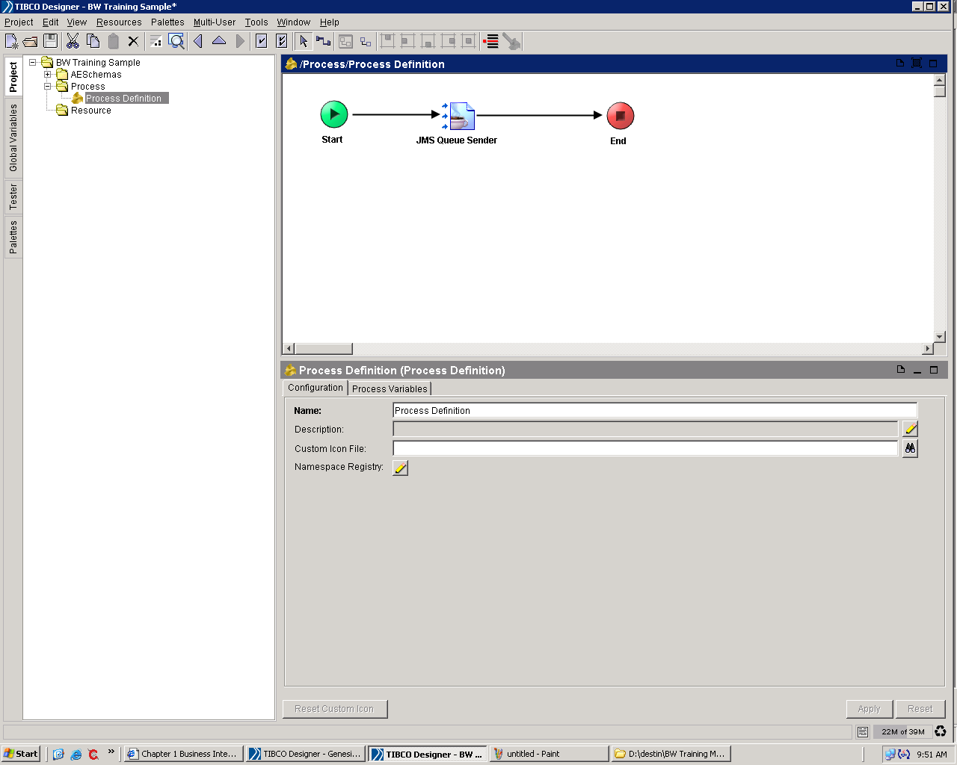
Drag & Drop to Develop

Slide 4
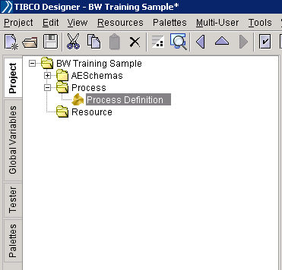
Project Tab
Project structure
  Add & Delete Directory
  Add & Delete Process
  Add & Delete Resource

Slide 5
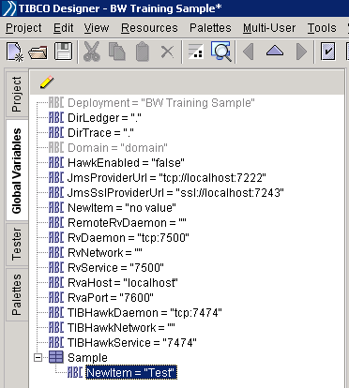
Global Variables Tab
Define Global Variables
  Use GV in different process
  Use GV to set up the service configuration
  Use GV to centralize control the variables

Slide 6
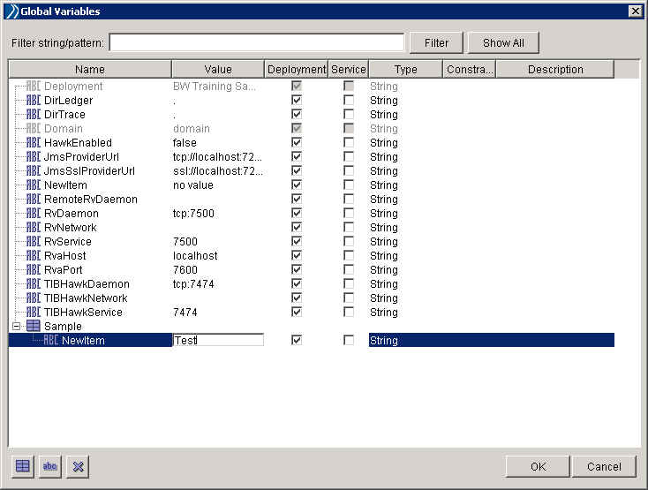
Global Variables Tab
Edit Global Variables
  Name & Value pattern
  Deployment & Service
  Type
  Constraint & Description

Slide 7
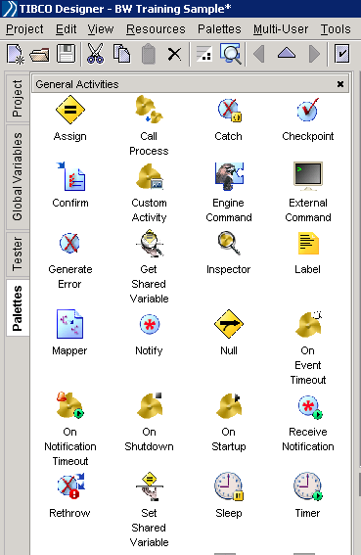
Palettes Tab
Select Activities
  Select Catalog
  Drag and drop one activity to your process
  Set the activity’s attribute

Slide 8
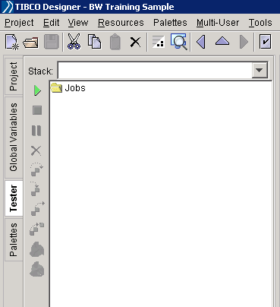
Tester Tab
Test your process
  Click the Start
  Select the process
  Click the load select

Slide 9
Activities
EMS
  Message service
Database
  Data store
XML
  Data format
IPE
  Work flow control
Java Code
  Special case

Slide 10
EMS
JMS Connection
  EMS URL
  User name and Password
  SSL setting
JMS Queue Sender/JMS Topic Publisher
  Set the JMS connection
  Select the message type
  Input the content
  Input the destination
  Send out the message

Slide 11
EMS
JMS Queue Receiver/JMS Topic Subscriber
  Set the JMS connection
  Select the message type
  Input the destination
  Receive the message

Slide 12
Exercise A: Send and Receive
Use BW to send out message to queue
Use BW to receive message from queue
Start both processes send a message to yourself

Slide 13
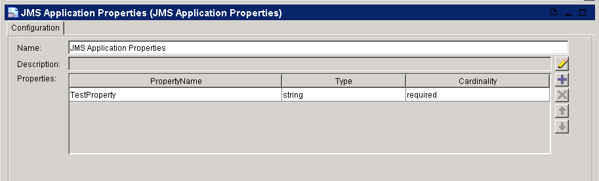
Message Selector
JMS Application Properties
  Add the properties
  Set the name & value pattern

Slide 14
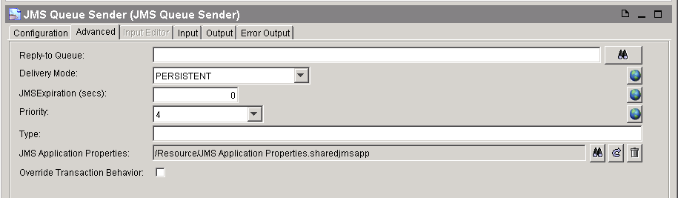
Message Selector
Use JMS Properties
  Set JMS Properties in the advanced tab (queue sender/topic publisher)

Slide 15
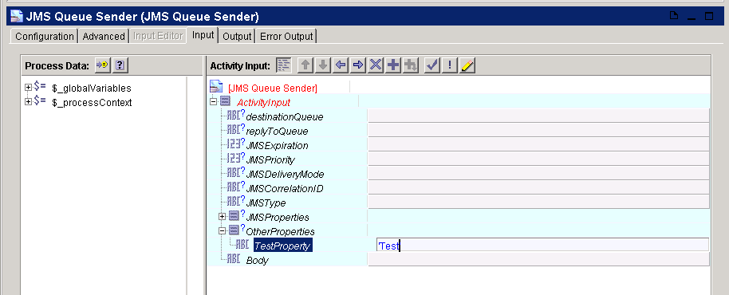
Message Selector
Send message with properties
  Input the value of the properties

Slide 16
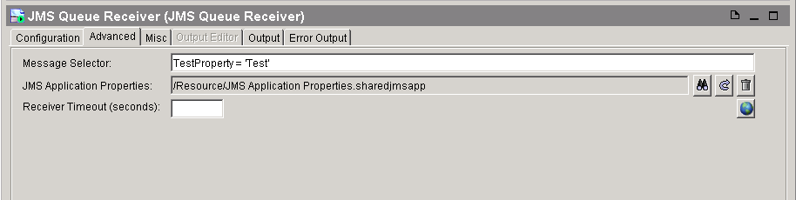
Message Selector
Message Selector
  Select JMS properties (queue receiver/topic Subscriber)
  Input the message selector statement

Slide 17
Exercise B: Message Selector
Use BW the send a message with different property
Use BW to receive the message which you want

Slide 18
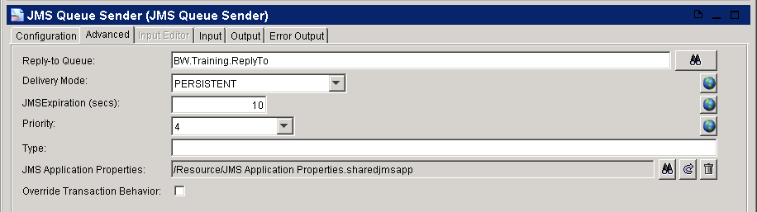
Advanced EMS
Reply To
  Send message and define the destination of the response

Slide 19
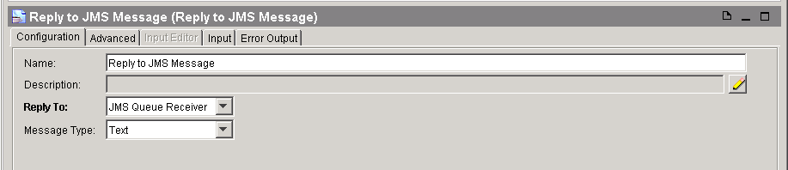
Advanced EMS
Use Reply to JMS Message
  Set Reply To property

Slide 20
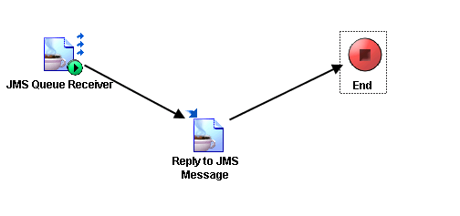
Advanced EMS
Reply To

Slide 21
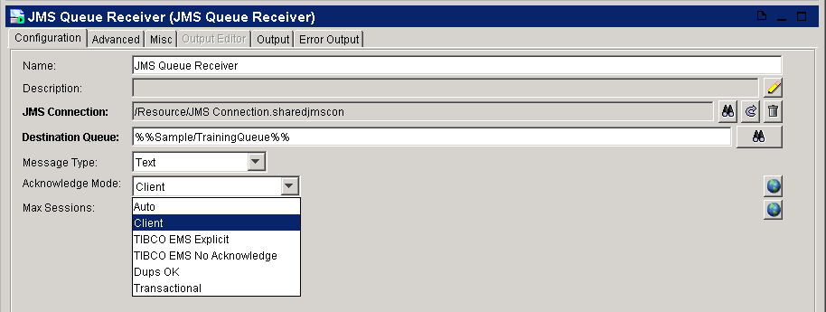
Advanced EMS
Acknowledge Mode
  Auto – automatically confirm the message after received
  Client – confirm the message manually

Slide 22
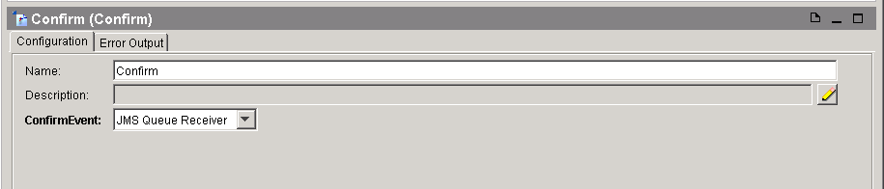
Advanced EMS
Confirm
  Set confirm event

Slide 23
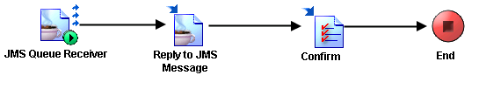
Advanced EMS
Confirm after Reply

Slide 24
Q&A

